Slide 1
Hidden Risks of Faster Payments
RDC Forum
Minneapolis, MN
August 28, 2019

Slide 2
Topical Agenda
Background
Faster (Real-time) Payments – Perspective and Reality
Status of Faster (Real-time) Payments in U.S.
Scenarios with One or More Providers of Payment Services
Directories
What are They and Why are They Needed?
Scenarios with One or More Directories
Who is Liable for Erroneous/Untimely Payments and for How Much?
Closing Comments
Summary
Additional Information

Slide 3
Background

Slide 4
Real-Time Payments
The Goals
Instantaneous payments from anyone to anyone any time from any place to any place
Ubiquitous payments 24X7X365
End user to end user
Secure payments
Immediate good funds
Irrevocable

Slide 5
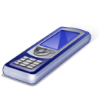
Real-Time Payments User Perspective
Poof!
Payment
Sender
Beneficiary
Sender
Beneficiary

Slide 6
Real-Time Payments Reality
Current Status
There are no ubiquitous, end user to end user, 24x7x365, real-time payments systems in the U.S!
There are payment options that appear to be real-time…at least some of the time!
Real-time payments requirements
Real-time posting of customer accounts by all financial institutions, 24X7X365
Real-time settlement of FI accounts with Federal Reserve, 24X7X365
Network connections between/among all parties in the U.S
Legal environment to define and support faster (real-time) payments

Slide 7
End-User to End-User Reality
Payment Instruction
Poof!
Notification of Receipt
Account Set Up
Account Set Up
Sender
Beneficiary
Sender
Common
Provider
Prefunding of Account
Beneficiary
Prefunding of Account
Real time only, 1) after prefunding and 2) if both parties participate with same provider

Slide 8
Two Providers – One Per User
Notification
of Deposit
Payment
Instruction
Account
Setup
Account
Setup
Provider
Provider
End User
End User
Prefunding
Sender
Payment
Prefunding
Payment request
Beneficiary
After account setup and funding, may take a day or longer to receive payment and payment notification
Not real-time!

Slide 9
End User to End User
With Hundreds of Millions of End Users and Multiple Providers of Faster Payments
How does any user know or have access to the banking information of every other user
To route a payment to a beneficiary?
To deposit a payment into a beneficiary’s account?

Slide 10
Multiple Providers
End Users
Providers
End Users
Account Set Up
Account Set Up
Account Set Up
User A uses only Providers 1 & 2 and User F uses only Provider 3
1
User A
User D
2
How does User A send a payment to User F?
User B
User E
3
User C
User F

Slide 11
Payment with Multiple Providers
End Users
Providers
End Users
Account Set Up
User A’s Bank
Account Set Up
Payment
Instruction
Payment Instruction
1
User A
User D
Provider 1 needs to get the payment to Provider 3
Payment
2
User B
User E
How does User A’s Bank know User F’s Bank?
Deposit Notice
User F’s Bank
3
Sends Deposit Notice
User C
User F

Slide 12
One Provider Per User – Multiple Users/Providers
Notification of Deposit
Providers
Notification of Deposit
Account Set Up
Account Set Up
Account Set Up
Still complex and may take a day or longer to receive payment and payment notification
Payment Instruction
Payment Instruction
Prefunding
Prefunding
User A
Request
Request
User D
Payment
Payment
How do 248 million adults using 10 thousand FI know everyone’s banking information?
User B
User E
User C
User F

Slide 13
Directories

Slide 14
Directory Provides Routing & Acct Info
Account Info.
Requests User B’s Info.
Sends
Payment
Instruction
User A
Account Info.
Retrieved for Payment
Shared
Directory
User B
Deposit
Notice
Sent
Sender
Beneficiary
Payments Routed to Beneficiary
Bank A
Bank B

Slide 15
Key Questions About Directories
Who is Liable for Erroneous and/or Untimely Payments?
Sender, beneficiary, sender’s bank, beneficiary’s bank, provider of faster payment service, provider of directory service, party initiating directory entries, party accepting directories entries?
For How Much is the Liable Party Liable?
The amount of the payment?
Consequential/proximate damages?
Can the Liable Amount be Shared Among the Parties?
Comparative negligence

Slide 16
Directory Update - Multiple Sources
Acct Info.
User A
Acct Info.
User B
Acct Info.
Shared
Directory
Acct Info.
Acct Info.
Acct Info.
Willie Sutton
Directory
Model
Provider
Provider

Slide 17
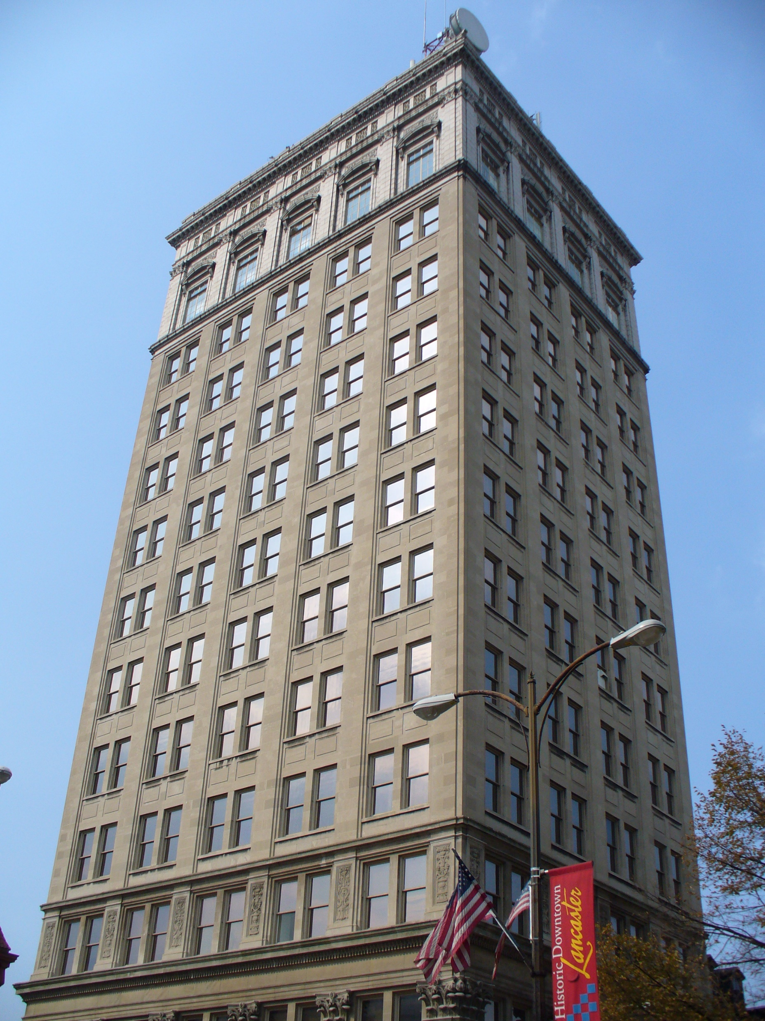
Two Directories - Acct Info Updates
Acct Info.
Directory
Directory
Acct Info.
User A
Acct Info.
User B
Acct Info.
Acct Info.
Provider
Provider

Slide 18
Key Questions About Directories
Who is Liable for Erroneous Payments?
Sender?
Beneficiary?
Sender’s bank?
Beneficiary’s bank?
Provider of faster payment service?
Provider of directory service?
Party initiating directory entries?
Party accepting directories entries?
Others?

Slide 19
Real-Time Payment & Directory Maintenance
9:00
AM
9:00:15
AM
9:00:20
AM
9:00:41
AM
9:01
AM
Directory
Maintenance
Received Changing Bene’s Account Info
Directory
Maintenance
Complemented
Directory Queried
for Routing &
Posting Info
Payment
Received by
Bene’s Bank
Known As of 9:00:15
Payment
Not Received By
Bene’s New Bank
As of 9:00:41
Payment
Initiated by
Paying Party
Response to Query
Received & Payment
Sent to Bene’s Bank
Known As of 9:00:15
9:00
AM
9:00:40
AM
9:00:50
AM
9:01
AM

Slide 20
Key Questions About Directories
Who is Liable for Erroneous Payments Because of Untimely Directory Maintenance?
Sender?
Beneficiary?
Sender’s bank?
Beneficiary’s bank?
Provider of faster payment service?
Provider of directory service?
Party initiating directory entries?
Party accepting directories entries?
Others?

Slide 21
Timing of Payment vs Two Directories
9:00
AM
9:00:20
AM
9:00:41
AM
9:00:42
AM
9:01
AM
Directory 2
Queried for Bene’s Account Info
Directory 1
Maintenance
Complemented
Directory 2
Receives Update
from Directory 1
Directory 1 Maint.
Received for Acct. Info
Payment
Received by
Bene’s Bank
Known As of 9:00:20
Payment
Not Received By
Bene’s New Bank
As of 9:00:41
Directory 2 Response
Received & Payment
Sent to Bene’s Bank
Known As of 9:00:20
Payment
Initiated by
Paying Party
9:00
AM
9:00:15
AM
9:00:40
AM
9:00:50
AM
9:01
AM

Slide 22
Key Questions About Directories
Who is Liable for Erroneous Payments Because of Untimely Directory Maintenance?
Sender?
Beneficiary?
Sender’s bank?
Beneficiary’s bank?
Provider of faster payment service?
Provider of directory service?
Party initiating directory entries?
Party accepting directories entries?
Others?

Slide 23
Key Questions About Directories
For How Much is the Liable Party Liable?
The amount of the payment?
Consequential/proximate damages?

Slide 24
Proximate Damages
User Opens a New Bank Relationship
Add account at Bank B to existing account with Bank A
Both accounts remain open
There are Multiple Directories and All have been Notified of the User’s New Account Prior to any Payments
Some directories perform maintenance in real-time
Some directories perform maintenance once a day at the EOD
User Redirects Deposits into New Account
User is making payments out of its new account
User is expecting deposits into its new account to cover payments
Problem
The directory update is not completed by all directories before User makes insurance premium payment
Balance in new account is insufficient to cover premium amount
Insurance coverage lapses followed by the occurrence of the insured event
Question
Is the liable party responsible for the total cost of the insured event plus other out of pocket expenses?

Slide 25
Addressing Risks
Faster Payments / Real-Time Payments are Not Defined in Law
Traditional Method to Address this Gap is Through Agreements (rules)
Two Types of Rules Needed to Allocate Risk
Payment rules (agreements)
Directory rules (agreements)
Two Sets of Rules Needed
Private sector rules (agreements)
Federal Reserve rules (operating circulars)
To Date no Private Sector Organization Has Committed to Provide Necessary Uniform Agreements

Slide 26
Summary

Slide 27
Hidden Risks
Faster (Real-time) Payments Include Many New Risks
Risks associated with the payment
Risks associated with the information used to route the payment to the correct bank and customer account using directories
Directory Risks
Which party is liable and for what?
For how much is the liable party liable?
Amount of the payment?
Consequential damages?
The Risks of Faster (Real-time) Payments are Not Well Understood
Amounts and type of risks vary with each payment scenario
Need to understand your risks in order to mitigate
Faster Payments can be Defined and Risks Allocated Through Agreements

Slide 28
Additional Information
Additional Information is Available
On Remotedeposit.com website
https://www.remotedepositcapture.com/papers/Tiller-Endeavors/The-Hidden-Risks-of-Faster-Payments.aspx
White paper entitled The Hidden Risks of Faster Payments
By Tiller Endeavors, LLC

Slide 29
Hidden Risks of Faster Payments
David Walker
David.walker@tillerendeavors.com
214.642.9268
https://tillerendeavors.com/

