Slide 1
ANS X9.100-140 Specifications for an
Image Replacement Document – IRD
Image and Document Flow Overview
Andy Garner
December 8, 2003
Updated: April 9, 2007
Slide Number 1

Slide 2


ANS X9.100-140 Specifications for an
Image Replacement Document – IRD
IRD Image and Document Flow Overview
[1] An original check is presented to Bank 1, the Bank of First Deposit
(BOFD 1) and then processed.
[2] Bank 1 (Truncating Bank) creates an image from the original check and sends electronic data and the image to Bank 2.
[3] Bank 2 passes along the Image and data received from Bank 1, adding an electronic endorsement.
€
0145
0145
0145
Check
Check Image
Check Image
Deposit Customer
Bank 1
BOFD
Bank 2
FED
Bank 3
INTERMEDIARY
€
NSF
NSF
Original IRD
5A031000011A B0000029545B
Original IRD
Original IRD
Bank 3
INTERMEDIARY
Bank 4
PAYOR
Bank 1
BOFD
Deposit Customer
[4] Bank 3 generates an original IRD and sends it to Bank 4.
[5] Bank 4 (paper-only) processes the original IRD and returns it NSF to Bank 1.
[6] The original IRD is “returned” to the customer.
Note: Illustrations are not fully representative
of actual documents and images.

Slide 3
ANS X9.100-140 Specifications for an
Image Replacement Document – IRD
IRD Image and Document Flow Overview (cont.)
€
SF
€
NSF
NSF
SF
Xxxx
Xxxxx
xx
Xxxx.........121.22
Xxxxxx......3210.33
Xxxxx........456.92
Xxxxxx........67.95
3856.42
Original IRD
IRD Image
Subsequent IRD
Deposit Customer
Bank 5
BOFD 2
Bank 6
FED
Bank 4
PAYOR
Issuing Customer
[7] The original IRD “returned” to the customer and re-deposited
at Bank 5 (BOFD 2).
[8] Bank 5 truncates the original IRD, creating images from it, and sends electronic data and the IRD images to Bank 6.
[9] Bank 6 prints a subsequent IRD from the X9.37 Data and Image received from Bank 5. The subsequent IRD is sent to Bank 4.
[10] Payment is made. Issuing customer receives the subsequent IRD with the monthly statement issued
by Bank 4.
Note: Illustrations are not fully representative
of actual documents and images.

Slide 4
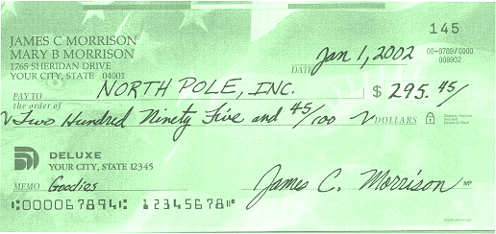

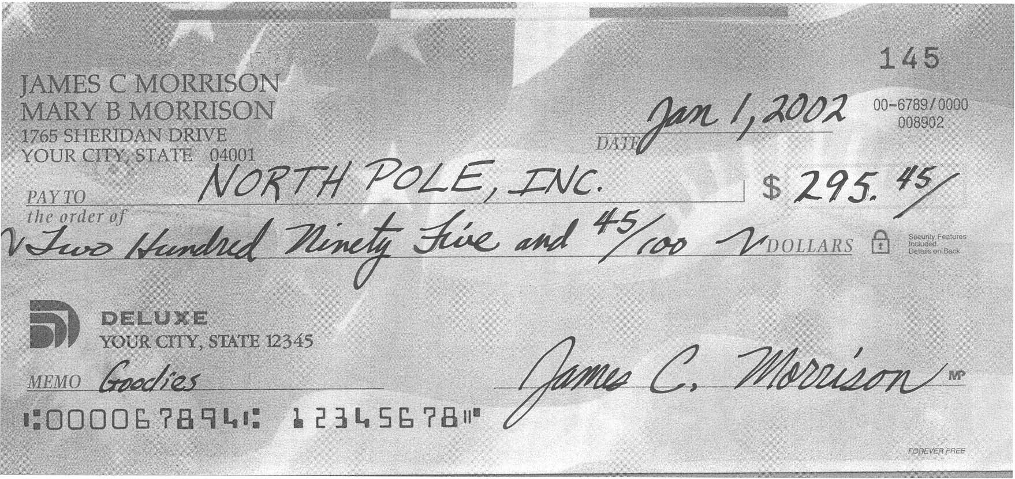
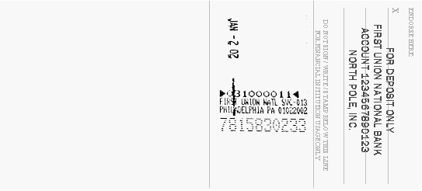
Steps 1 and 2 Processing
An original check is presented and processed by Bank 1, the Bank of First Deposit (BOFD 1).
Physical
Document
0145
BOFD 1 (Bank 1) sprayed endorsement.
Note: Endorsement would not appear in the image
if it is done after the image capture.
Image
0145
BOFD endorsement and truncating data for Bank 1 in X9.37 file.
Bank 1 (Truncating Bank) creates an image from the original check and the X9.37 image file is sent to Bank 2.
Bank 1
Bank 2
Note: Illustrations are not fully representative
of actual documents and images.

Slide 5
Step 3 Processing
Bank 2 passes along the Image and data received from Bank 1, adding an electronic endorsement.
Image
0145
Bank 2 sends image and Endorsement data in X9.37 File to Bank 3.
Bank 2
Bank 3
Note: Illustrations are not fully representative
of actual documents and images.

Slide 6
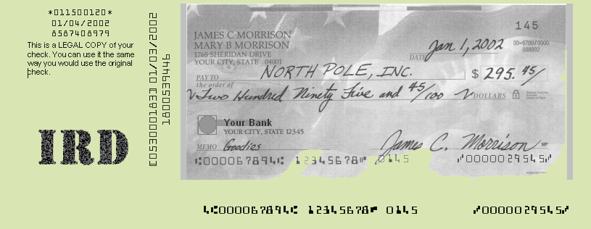
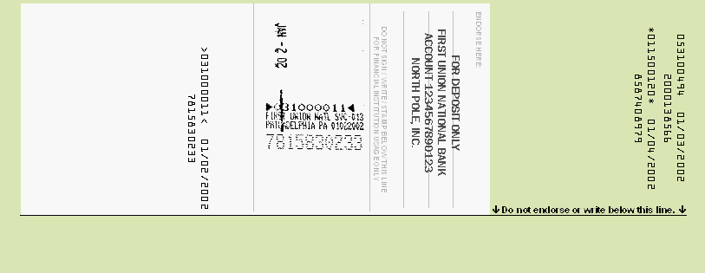
Step 4 Processing
Bank 3 creates an original IRD (1) from the X9.37 Data and Image received from Bank 2 and sends document to Bank 4.
Image
0145
X9.37 Original Truncating Bank Data (Bank 1) printed when IRD created. Original Bank 1 image inserted in the IRD.
Bank 1 (BOFD 1) sprayed endorsement in original image and printed when IRD created.
0145
Banks 2 and 3 endorsements printed when IRD created.
Bank 3 Data
Physical
Document
[031000011] 01/02/2002
7815830233
0145
EPC “4” indicates an IRD.
Note: Illustrations are not fully representative
of actual documents and images.

Slide 7
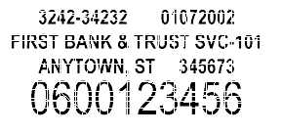
Steps 5 and 6 Processing
Bank 4 (paper-only) processes the original IRD and returns it NSF to Bank 1. Bank 1 “returns” the IRD to the customer.
Bank 4 sprays a Physical Endorsement
NSF
Physical
Document
[031000011] 01/02/2002
7815830233
*011500120* 01/04/2002
8587408979
0145
5A031000011A B0000029545B
Bank 1 removes the return strip prior to the original IRD being given to the depositing customer.
Qualified Return Strip applied by Bank 4.
Bank 4 stamps return reason on physical document.
ECP “5” indicates a return IRD.
Note: Illustrations are not fully representative
of actual documents and images.

Slide 8

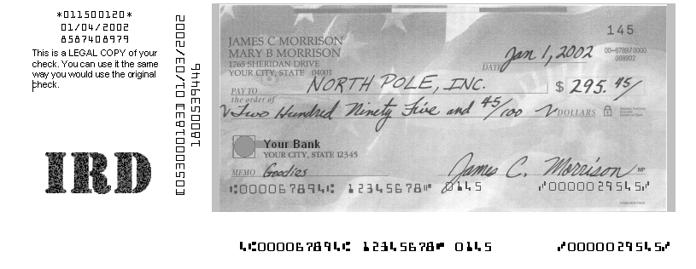
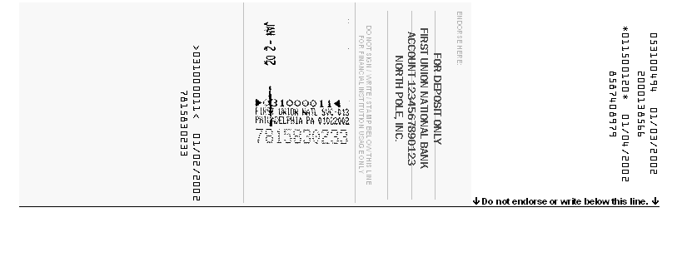
Steps 7 and 8 Processing
The customer “redeposits” the original IRD at Bank 5 (BOFD 2). Bank 5 truncates the original IRD, creating images (front and back) of the original IRD, and sends electronic data and image to Bank 6.
Bank 5 sprays a Physical Endorsement prior
to image capture.
NSF
Physical
Document
[031000011] 01/02/2002
7815830233
[031000011] 01/02/2002
7815830233
0145
NSF
Image
[031000011] 01/02/2002
7815830233
Although Bank 5 truncates the original IRD, Bank 1 remains the Truncating Bank.
Note: Illustrations are not fully representative
of actual documents and images.

Slide 9
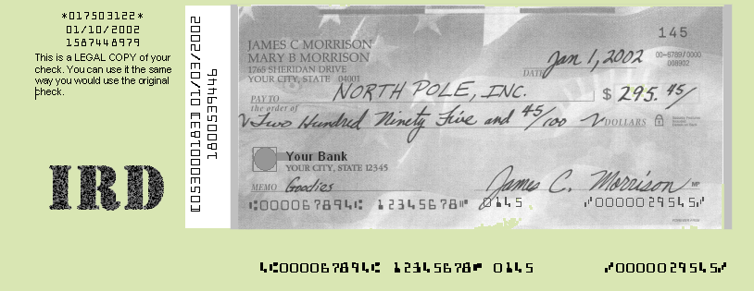
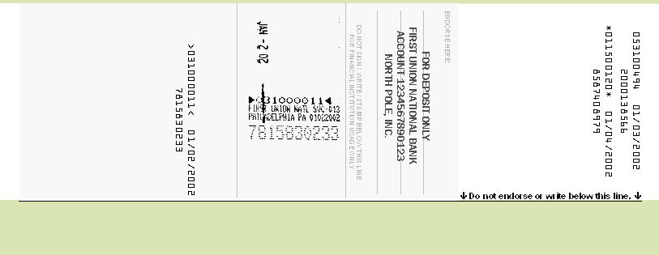
Step 9 Processing
Bank 6 prints a subsequent IRD from the X9.37 Data and Image received from Bank 5 (BOFD 2). The subsequent IRD is sent to Bank 4.
NSF
Image
[031000011] 01/02/2002
7815830233
Bank 6 Subsequent IRD creation data.
NSF
Physical
Document
[031000011] 01/02/2002
7815830233
*017503122* 01/10/2002
1587448979
>053000183< 01/07/2002
1800539446
Electronic endorsements for Bank 5, the second BOFD, (left) and Bank 6 (right) are printed when
the IRD is created.
Bank 6 Subsequent IRD creation data.
Note: Illustrations are not fully representative
of actual documents and images.

Slide 10
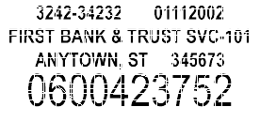
Step 10 Processing
Payment is made by Bank 4.
Issuing customer receives the subsequent IRD with the monthly statement
issued by Bank 4.
Bank 4 sprays a physical endorsement upon receipt, processes the IRD as a check, and makes payment.
Bank 6 is identified as the creator of the subsequent IRD.
The identity of the original truncating institution is always known.
NSF
Physical
Document
[031000011] 01/02/2002
7815830233
*>053000183<* 01/07/2002
1800539446
*017503122* 01/10/2002
1587448979
Bank 5 (BOFD 2) electronic BOFD endorsement information is printed in the defined area of the subsequent IRD.
Bank 6 electronic subsequent endorsement information is printed in the defined area of the subsequent IRD.
Note: Illustrations are not fully representative
of actual documents and images.

Slide 11
X9.37 Elements Within an IRD, Front
Region 2F, Original Check Truncation Institution.
Forward IRD
Section 11, Addendum A (Type 26), Fields 3, 4 and 5, if Field 9 is flagged “yes.”
Section 13, Addendum C (Type 28), Fields 3, 4, and 5, if Field 6 is flagged “yes.”
Return IRD
Section 15, Return Addendum A (Type 32), Fields 3, 4, and 5, if Field 9 is flagged “yes.”
Section 18, Return Addendum D (Type 35), Fields 3, 4, and 5, if Field 6 is flagged “yes.”
(If more than one truncator is indicated, then the earliest dated addendum would be used.)
Region 3F, Creation Institution.
Not from X9.37.
Region 1F, Return Reason Overlay. First two lines match the text in Region 7F.
Region 1F, Item Front.
Section 21, Image View Detail Record (Type 50), Field 8.
Section 22, Image View Data Record (Type 52), Field 19.
Region 4F, Legend. Selected by Creator.
Not from X9.37.
NSF
Region 7F, Return Reason. Selected by Creator.
Section 14, Return Record (Type 31), Field 6.
[031000011] 01/02/2002
7815830233
0145
5A031000011A B0000029545B
Region 8F, Optional Data. Selected by creator.
Not from X9.37.
Region 6F, Qualified MICR Return Region. Check Detail Addendum A Record (Type 26), Field 3. Check Detail Record (Type 25), Field 7.
Region 5F, Required MICR Region.
Forward IRD
Section 10, Check Detail Record (Type 25),
Fields 2, 3, 4, 5, 6 and 7.
Return IRD
Section 14, Return Record (Type 31), Fields 2, 3, 4, 5, and 11.
Section 16, Return Addendum B (Type 33), Field 3.

Slide 12
X9.37 Elements Within an IRD, Back
Region 1B, Initial BOFD Endorsement Overlay Area.
Forward IRD
Section 11, Addendum A (Type 26), Fields 3, 4 and 5.
Return IRD
Section 15, Return Addendum A (Type 32), Fields 3, 4, and 5.
*011500120* 01/04/2002
8587408979
Region 1B, Subsequent Endorsement Overlay Area for Initial IRD.
Forward IRD
Section 13, Addendum C Record (Type 28), Fields 3, 4, and 5.
Return IRD
Section 18, Return Addendum D (Type 35), Fields 3, 4, and 5.

